Slide 1

Project name: Unstructured breast mammogram data analysis using convolutional approach for effective classification and detection
Project guide: Prof. Debkumar Chowdhury
Prof. (Dr.) Shibaprasad Sen
Department of Computer Science
University of Engineering & Management, Kolkata
Tirtharaj Sinha | 3I(CSE) | 74 | 12019009001134
Anurag Unnikannan | 3J(CST) | 09 | 12019009001281
Susmit De | 3J(CST) | 72 | 12019009022078
Siddhartha Bose | 3I(CST) | 58 | 12019009022034
Arnobrata Ghosh | 3C(CSE) | 13 | 12019009001398
Devesh Raj | 3C(CST) | 21 | 12019009022196

Slide 2
Contents
Introduction
1.1. Background and motivation
1.2. Objective
Literature survey
2.1. Survey table
Proposed methodology
Experimental result
4.1. Result analysis
4.2. Application result
Conclusion and future scope
5.1 Conclusion
5.2 Future scope
Reference

Slide 3
1. Introduction
1.1 Background and motivation
Breast Cancer is considered to be most common nowadays. According to the December 2020 statistics of the World Health Organization (WHO) among 24.5% of world's female cancer population is affected by this disease. It starts spreading from breast. At the early stage of this disease, the cancerous cells we may be found as a tumor or lump, which is clearly visible from the X-Ray.
Hence, it is considered as a serious issue of society and an automated computer-based method is required to detect and classify breast cancer with precision. This method helps the medical practitioner to start early treatment and ultimately helps to reduce the fatality rate.
1.2 Objective
The inconclusive, incomplete, and dissatisfactory results of the previously proposed techniques encourage us to develop a novel breast mammogram classification and detection algorithm using a convolutional approach that works on unstructured data such as breast mammogram images [10] and displays the classified output using convolutional model architecture along with the satisfactory accuracy rate.

Slide 4
2. Literature Survey
2.1. Survey Table
The following table represents various pre-existing methods, along with their technique, advantages and disadvantages. All these methods are well appreciated but in our problem the results are unsatisfactory. Identification of these drawbacks helps us to update and modify our algorithm to obtain a better accuracy rate.
Table 1: Survey Table
Methodology | Advantages | Disadvantages
Decision Tree [1] | Decision trees require less effort for data preparation during pre-processing. | A small change in the data can cause a large change in the structure. According to our problem, it causes instability.
K-Nearest Neighbor [2] | No assumption about data. | KNN needs a huge amount of memory.
Random Forest Classifier [3] | Random forest minimizes the overfitting issue and tries to increase the accuracy score. | This method needs high computational power and resources.
Support Vector Machine [4] | It is effective in high-dimensional spaces. | Due to a huge time consumption issue, the performance of this method is not satisfactory when we apply this strategy in a large dataset.
Gaussian Naïve Bayes [5] | Naive Bayes is more appropriate for categorical input variables than numerical variables. In the context of our problem, this property is suitable. | It presumes that every feature of the dataset is independent. This property limits the application of this technique in real-world cases.
Multi-Scale Fusion U-Net [6] | It solves the problem of multi-scale variation in breast lesions and boundary pixel blurring. | For the different modes of images, segmentation effects will be reduced.

Slide 5
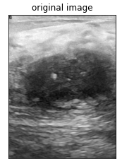
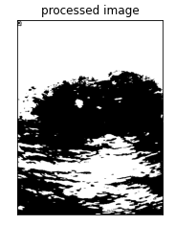
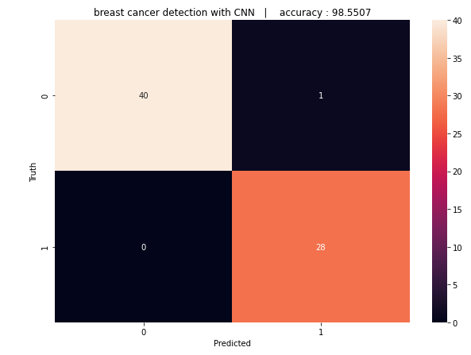
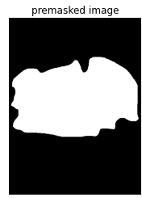
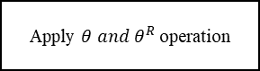
3. Proposed methodology
Our proposed methodology is focused on breast cancer classification and detection from an unstructured dataset (BUSI) using breast mammogram classification and detection algorithm using a convolutional approach. We have proposed a block diagram to show the main concept of the methodology at a glance as shown in Fig. 1.
Conversion of original image to greyscale image
Proposed filtration algorithm
Apply $θ and θ^{R}$ operation
Proposed methodology for cropped image generation.
Proposed segmentation approach for region of interest detection
Proposed convolutional model architecture
Fig. 1. The built-in architecture of mammogram classification and detection algorithm using a convolutional approach

Slide 6
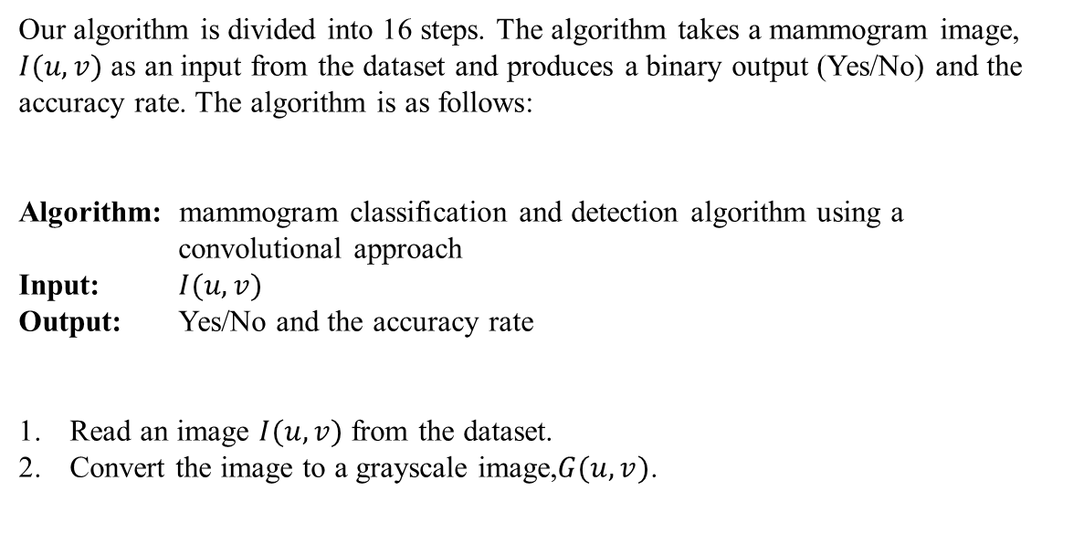
Our algorithm is divided into 16 steps. The algorithm takes a mammogram image, $I(u,v)$ as an input from the dataset and produces a binary output (Yes/No) and the accuracy rate. The algorithm is as follows:
Algorithm: mammogram classification and detection algorithm using a convolutional approach
Input: $I(u,v)$
Output: Yes/No and the accuracy rate
Read an image $I(u,v)$ from the dataset.
Convert the image to a grayscale image,$G(u,v)$.

Slide 7
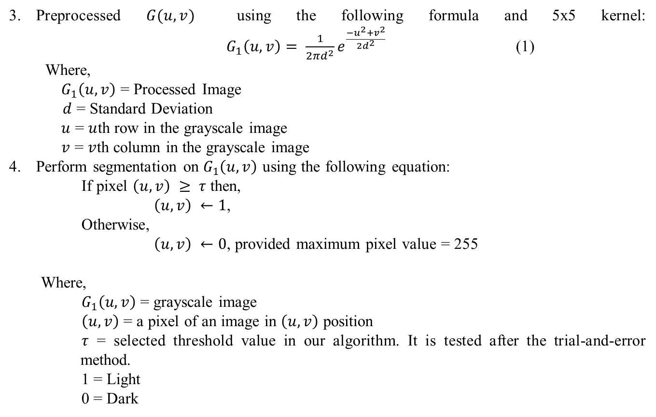
Preprocessed $G(u,v)$ using the following formula and 5x5 kernel: $G_{1}\left(u,v\right)= \frac{1}{2πd^{2}}e^{\frac{−u^{2}+v^{2}}{2d^{2}}}$ (1)
Where,
$G_{1}\left(u,v\right)$ = Processed Image
$d$ = Standard Deviation
$u$ = $u$th row in the grayscale image
$v$ = $v$th column in the grayscale image
Perform segmentation on $G_{1}\left(u,v\right)$ using the following equation:
If pixel $\left(u,v\right) ≥ τ$ then,
$\left(u,v\right) ←1$,
Otherwise,
$\left(u,v\right) ←0$, provided maximum pixel value = 255
Where,
$G_{1}\left(u,v\right)$ = grayscale image
$\left(u,v\right)$ = a pixel of an image in $\left(u,v\right)$ position
$τ$ = selected threshold value in our algorithm. It is tested after the trial-and-error method.
1 = Light
0 = Dark

Slide 8
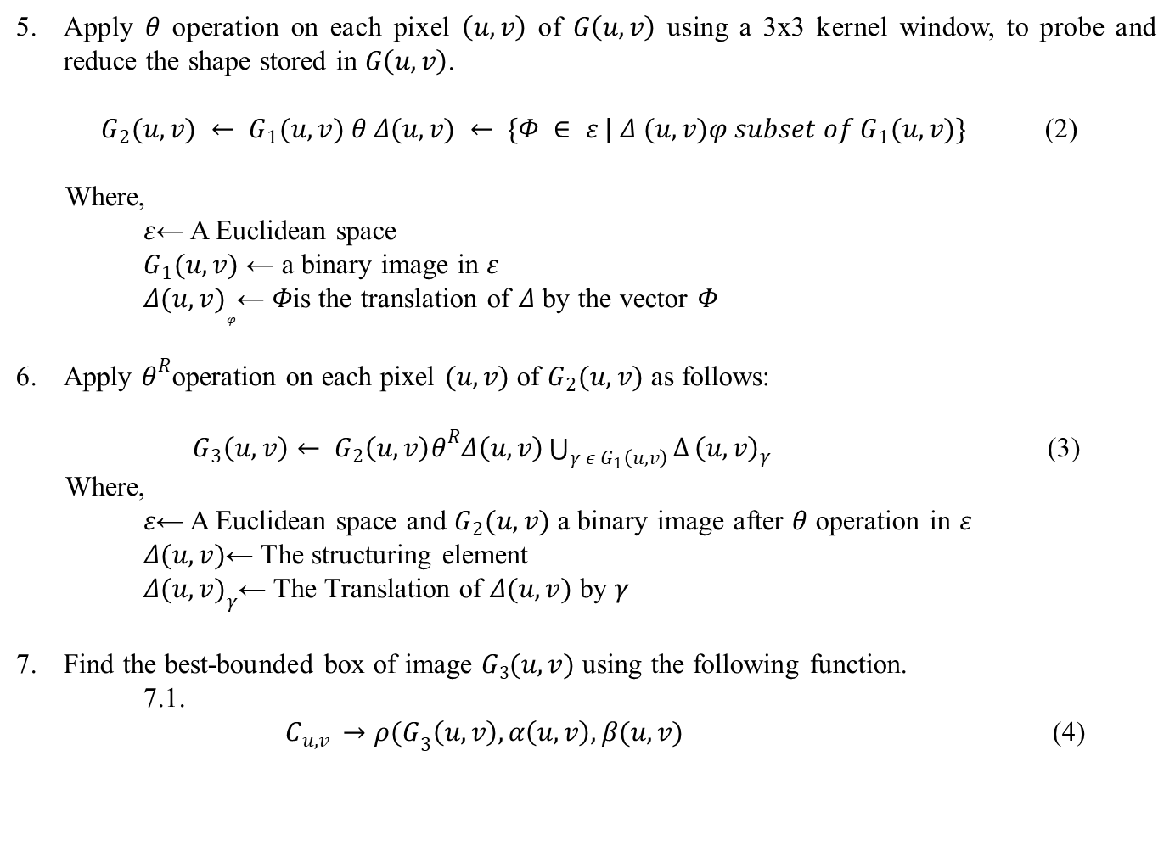
Apply $θ$ operation on each pixel $\left(u,v\right)$ of $G\left(u,v\right)$ using a 3x3 kernel window, to probe and reduce the shape stored in $G\left(u,v\right)$.
$G_{2}(u,v) ← G_{1}(u,v) θ Δ(u,v) ← \{Φ ∈ ε | Δ (u,v)φ subset of G_{1}(u,v)\}$ (2)
Where,
$ε$← A Euclidean space
$G_{1}(u,v)$ ← a binary image in $ε$
$Δ{(u,v)}_{φ}$← $Φ$is the translation of $Δ$ by the vector $Φ$
Apply $θ^{R}$operation on each pixel $(u,v)$ of $G_{2}(u,v)$ as follows:
$G_{3}\left(u,v\right)← G_{2}\left(u,v\right)θ^{R}Δ\left(u,v\right)\bigcup_{γ ε G_{1}\left(u,v\right)}{∆}{\left(u,v\right)}_{γ}$ (3)
Where,
$ε$← A Euclidean space and $G_{2}(u,v)$ a binary image after $θ$ operation in $ε$
$Δ(u,v)$← The structuring element
$Δ{(u,v)}_{γ}$← The Translation of $Δ(u,v)$ by $γ$
Find the best-bounded box of image $G3(u,v)$ using the following function.
7.1.
$C_{u,v }→{ρ(G}_{3}\left(u,v\right),α\left(u,v\right),β(u,v)$ (4)

Slide 9
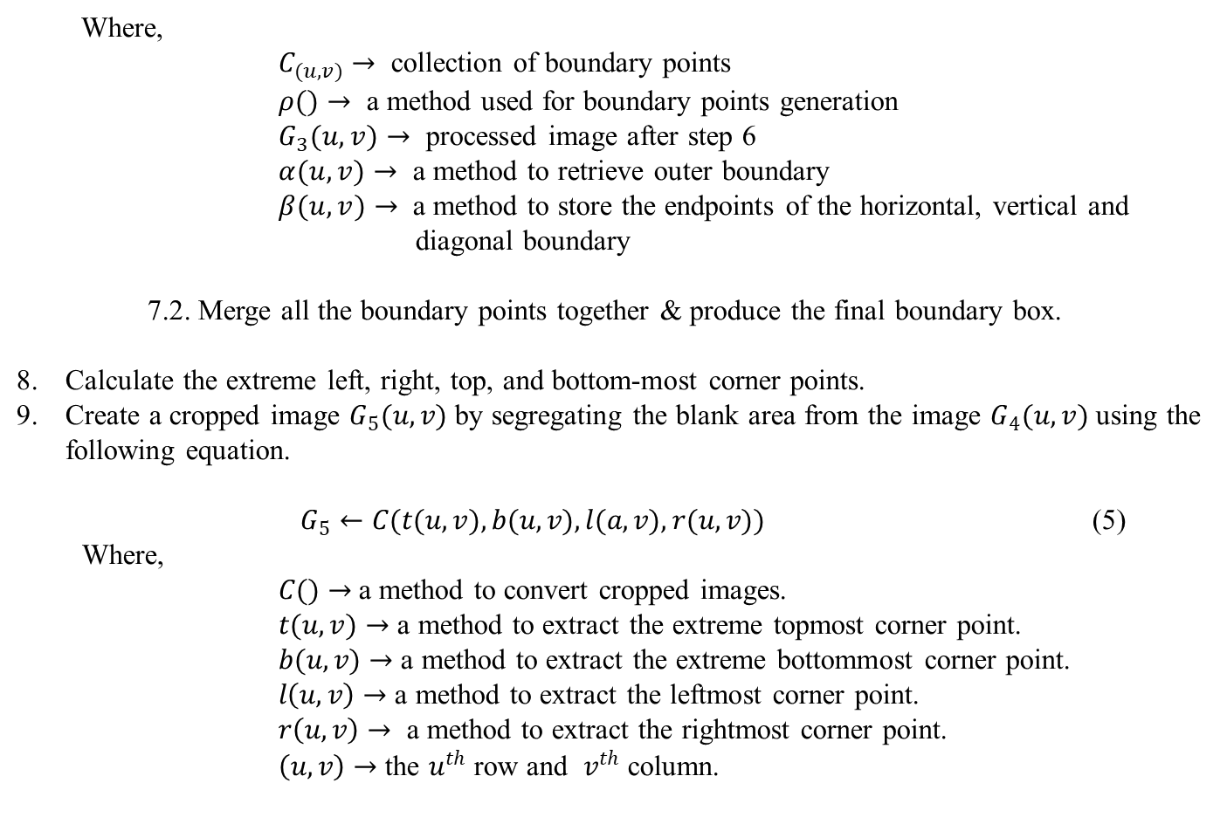
Where,
$C_{(u,v)}→$ collection of boundary points
$ρ()→$ a method used for boundary points generation
$G_{3}(u,v)→$ processed image after step 6
$α(u,v)→$ a method to retrieve outer boundary
$β(u,v)→$ a method to store the endpoints of the horizontal, vertical and diagonal boundary
7.2. Merge all the boundary points together & produce the final boundary box.
Calculate the extreme left, right, top, and bottom-most corner points.
Create a cropped image $G_{5}(u,v)$ by segregating the blank area from the image $G_{4}(u,v)$ using the following equation.
$G_{5}←C(t(u,v), b(u,v), l(a,v), r(u,v))$ (5)
Where,
$C()→$a method to convert cropped images.
$t(u,v)→$ a method to extract the extreme topmost corner point.
$b(u,v)→$ a method to extract the extreme bottommost corner point.
$l\left(u,v\right)→$ a method to extract the leftmost corner point.
$r\left(u,v\right)→$ a method to extract the rightmost corner point.
$\left(u,v\right)→$ the $u^{th}$ row and $v^{th}$ column.

Slide 10
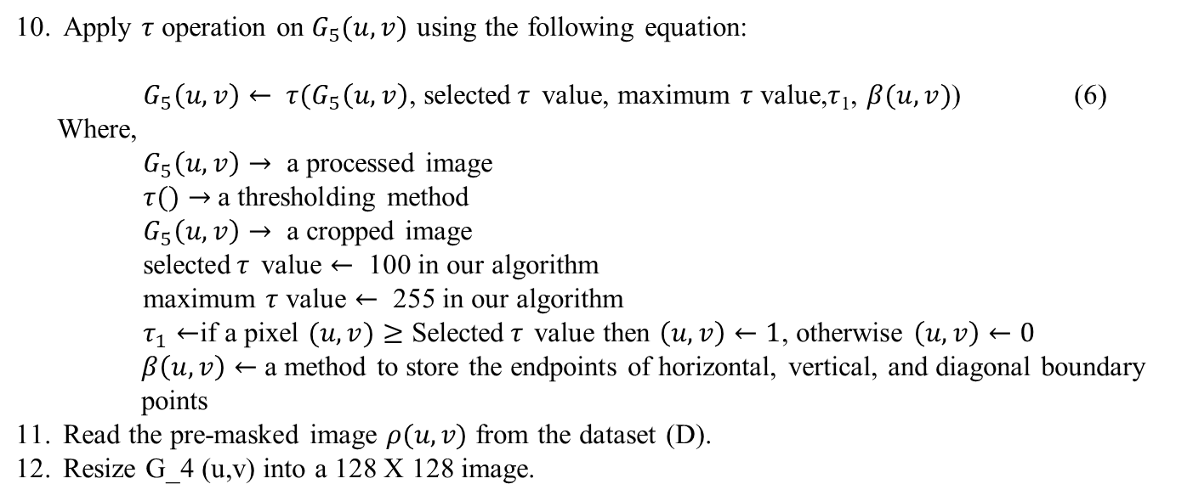
Apply $τ$ operation on $G_{5}(u,v)$ using the following equation:
$G_{5}\left(u,v\right)← τ{(G}_{5}\left(u,v\right)$, selected$τ$ value, maximum $τ$ value,$τ$₁, $β(u,v)$) (6)
Where,
$G_{5}\left(u,v\right)→$ a processed image
$τ()→$a thresholding method
$G_{5}\left(u,v\right)→$ a cropped image
selected$τ$ value $←$ 100 in our algorithm
maximum $τ$ value $←$ 255 in our algorithm
$τ_{1}←$if a pixel $(u,v)≥$ Selected$τ$ value then $\left(u,v\right)←1$, otherwise $\left(u,v\right)←0$
$β\left(u,v\right)←$a method to store the endpoints of horizontal, vertical, and diagonal boundary points
Read the pre-masked image $ρ(u,v)$ from the dataset (D).
Resize G_4 (u,v) into a 128 X 128 image.

Slide 11
Declaring A[n][2] list for each image for storing true and false sample values.
n ← total number of images
end_of_iterations← n-1
i ←no_of_iterations← 0
While (i≤end_of_iterations) then,
If G_6 (u,v) is a tumourous image then,
G_6 (u,v)←True
A[i][0] ← 1 and A[i][1]← 0
Go to Otherwise
IfG_6 (u,v)is a non-tumorous image then,
G_6 (u,v)← False
A[i][0] ← 0 and A[i][1] ←1
Go to Otherwise
Otherwise
i ←i + 1
Go to While
End If
End While
14. The proposed convolutional architecture is shown in Fig. 2. Each input x of size 128x128x3 is used to feed into the convolutional architecture. In the convolutional architecture following layers are observed:
a. One 2-dimensional convolution layer with kernel size 2x2

Slide 12
b. One 2-dimensional convolution layer with kernel size 2x2 and a rectified linear activation function.
c. One batch normalization layer
d. One 2-dimensional max pooling layer with pool size 2x2
e. One dropout layer
f. One 2-dimensional convolution layer of 64-bit input and a rectified linear activation function
g. One 2-dimensional convolution layer of 64-bit input and a rectified linear activation function
h. One batch normalization layer to calculate the mean output (close to 0) and the standard deviation output (close to 1)
i. One 2-dimensional max pooling layer with pool size 2x2
j. One dropout layer
k. One flatten layer
l. One dense layer and activation layer
m. One dropout layer
n. One dense layer with an activation softmax function.
Segregate the whole dataset [10] into two sections. We select 80% mammogram images from the dataset (BUSI) [10] for training purposes and 20% mammogram images from the dataset (BUSI) [10] for testing purposes.
We feed the training and testing data into the designed convolutional model architecture as shown in Fig. 2. given below.

Slide 13
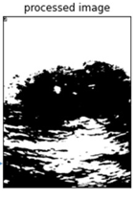
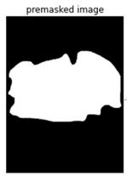
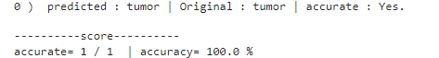
The proposed convolutional architecture is shown in Fig. 2. Each input x of size 128x128x3 is used to feed into the convolutional architecture.
Conv()
Bn()
2-dimensional Convolutional layer= (2,2)
2-dimensional convolutional layer of 32 bit (2,2)
RELU
Batch normalization
2-Dimensional Maxpooling
Pool size=(2,2)
Dropout Layer
=(0.25)
2-dimensional convolutional layer of 32 bit (2,2)
RELU
Batch normalization
Input image=(128,128,3)
(128,128,32)
(128,128,32)
(64,64,64)
2-Dimensional Maxpooling
Pool size=(2,2)
(32,32,64)
Dropout Layer
=(0.25)
(32,32,64)
Dropout
Dense
Flatten
(512)
(512)
(65536)
Fig. 2. Mammogram training and testing phase using proposed model architecture

Slide 14
4. Experimental results
4.1. Result analysis:
4.1.1. Findings
We consider the mammogram image dataset (BUSI) [10], which consists of 410 malignant and 130 non-malignant images collected from the dataset [10] and 209 malignant and 133 non-malignant pre-masked images to calculate the performance of mammogram classification and detection algorithm using a convolutional approach. The size, colour, and format of breast tumor images in the dataset [10] are similar in nature, whereas the resolutions of the images are different. The format of the mammogram images are ‘.png’ by nature.
We have applied our algorithm in the python environment, version 3.8, with the hardware configuration of the Intel Core i3 5th Generation processor,4GB DDR3 primary memory (RAM), and an integrated graphics card. Anaconda as a distributor of Python version 3.8 is used. jupyter notebook version 6.3.0 as an open web interface is used as a programming platform for the implementation of our algorithm.

Slide 15
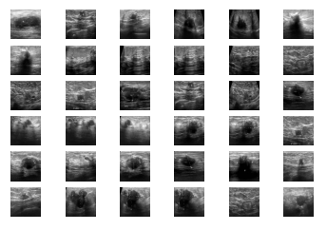
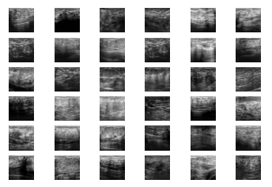
4.1.2. Image Reading
At first malignant and non-malignant images (410,130) and pre-masked images (209,133) are collected from the dataset to calculate the mammogram classification and detection.
After reading the images they were partitioned into two categories ‘Yes’(malignant) and ‘No’(non-malignant)
Fig. 3. Malignant images
Fig. 4. Non-malignant images

Slide 16
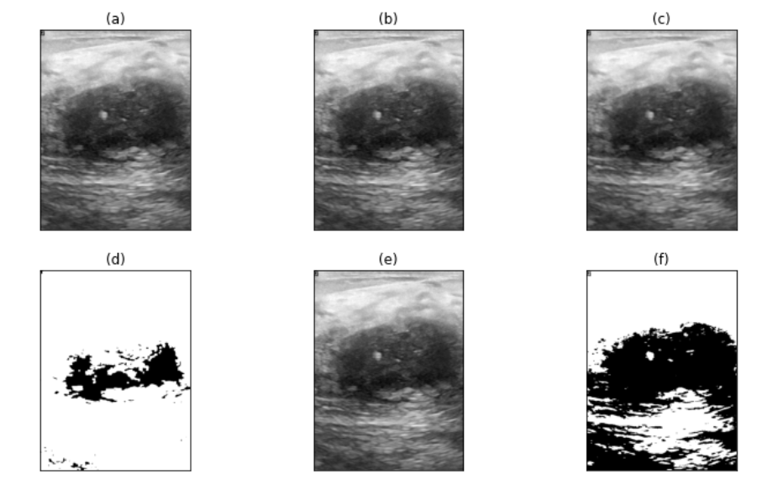
4.1.3. Image Segmentation
After reading all the images from the dataset each image will pass through the various steps of the algorithm as shown in Fig. 5.
Fig. 5. (a) original image (b) grayscale image (c) image after applying proposed filtration method (d) image after applying θ and θ^{R} operation (e) cropped image after applying proposed image cropping methodology (f) proposed segmentation approach for the region of interest detection

Slide 17
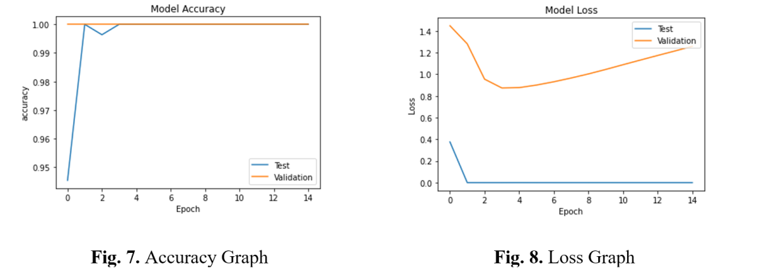
4.1.4. Post Training Findings –
The dataset is then splitted into training(80%) and testing(20%) sets.
After execution by our proposed algorithm it has been observed that the number of training samples are 344 and the number of testing samples are 69.
We have also achieved that the training shape values are (344,128,128,3) and (344,1).
Then we achieved a graph after calculating the accuracy and loss the during the testing and validation phase.
Fig. 6. Accuracy graph
Fig. 7. Loss graph

Slide 18
4.1.5. Comparative Study –
After a comparison of other existing classification methodologies with our proposed methodology as shown in Table 2, we can conclude that our proposed methodology overpowers the existing classification algorithms [7] [8] [9] in terms of F1 score and accuracy score.
Serial No. | Name of the classification algorithm | Accuracy Score | F1 Score
1. | Decision Tree [1] | 97% | 0.97
2. | K-Nearest Neighbor [2] | 94.2% | 0.94
3. | Gaussian Naïve Bayes [3] | 97% | 0.97
4. | Random Forest [4] | 97% | 0.95
5. | Support Vector Machine [5] | 96% | 0.96
6. | Multi-Scale Fusion U-Net [6] | 94% | 0.93
7. | Proposed Method | 98.5% | 0.98

Slide 19
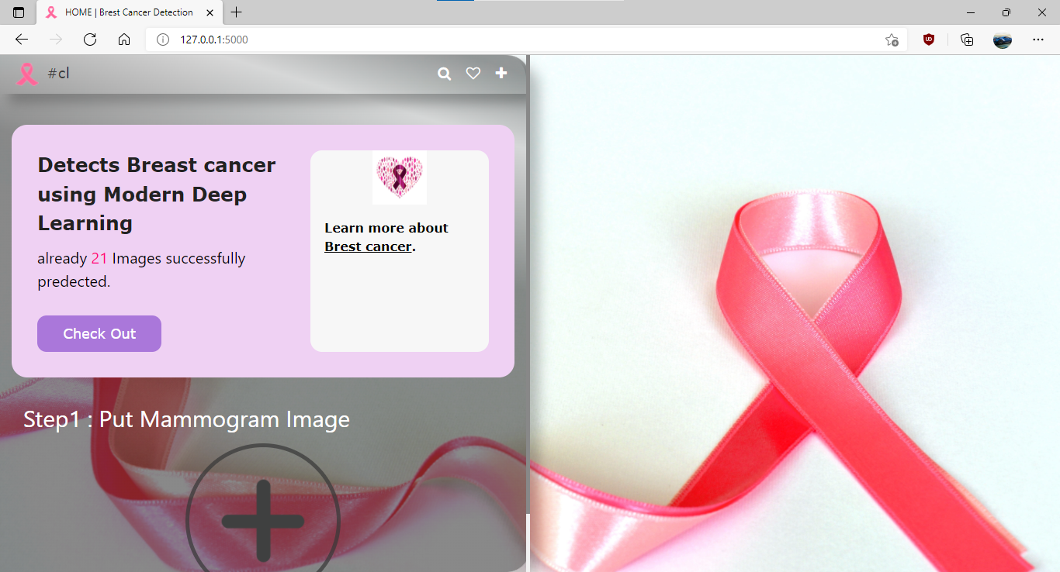
4.2 Application Results
For end users, we have made integrated our model into a web application, using a Python library, Flask. The figure below shows the user interface of the web application.
Step 1: Click on the ‘+’ (plus) icon to upload mammogram image.
Fig. 8. User interface of web application

Slide 20
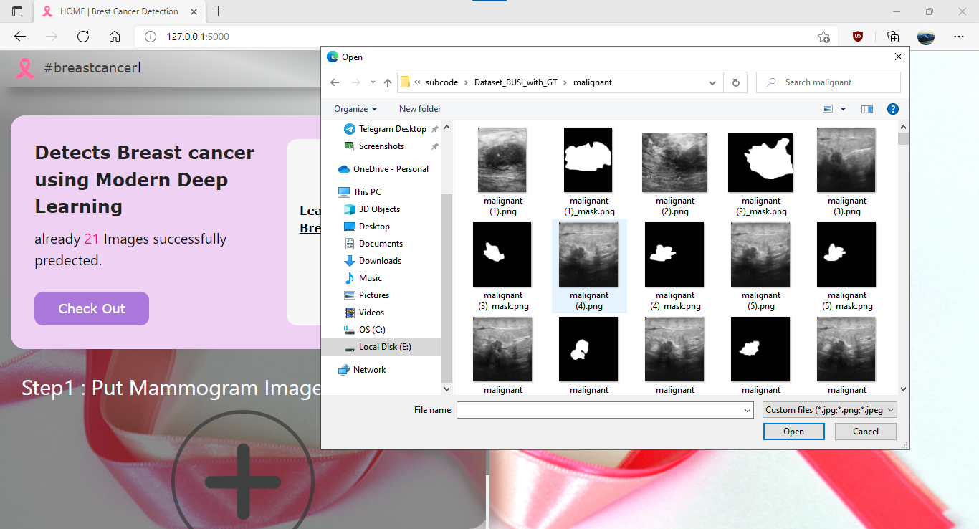
Step 2: Choose the desired mammogram image.
Fig. 4: Selecting mammogram image as input for prediction

Slide 21
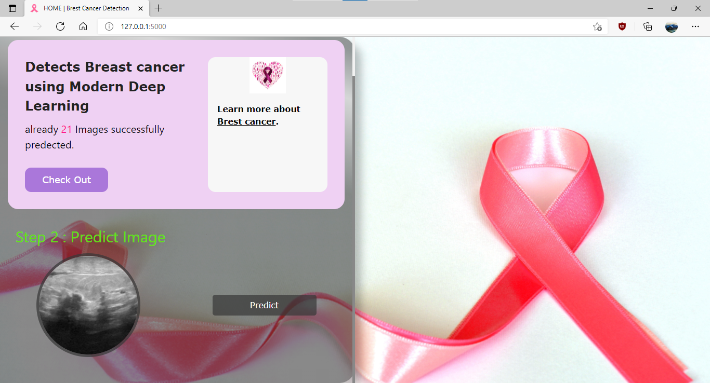
Step 3: Click on “Predict” button.
Fig. 9: Preview of the selected mammogram image

Slide 22
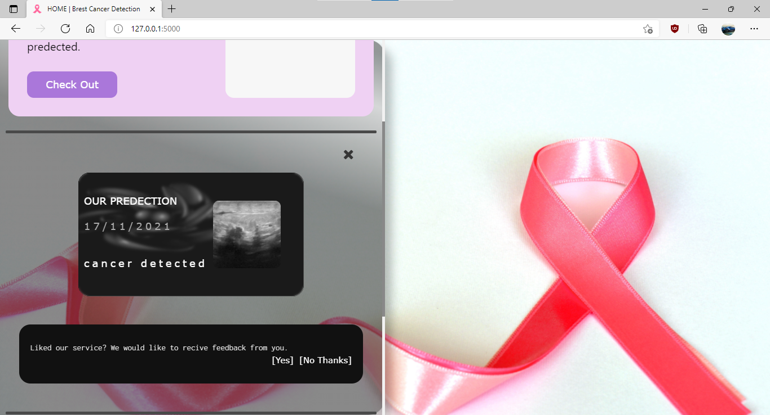
The following figure shows the result, that is, whether the mammogram image uploaded is Cancerous or Non-Cancerous. In this case, the image we gave as input is cancerous.
Fig. 10: Output page displaying the result of the uploaded mammogram image.

Slide 23
5. Conclusion & Future scope
5.1 Conclusion
This algorithm is capable of preprocessing unstructured breast mammogram images from the BUSI dataset , collected from the web resource. It is responsible for the prediction of malignant and non-malignant breast mammogram images in terms of yes (malignant sample) and no (non-malignant sample) values. It also generates an accuracy score through which we compare our proposed method with existing methods. The experiment result shows that after applying the proposed method and existing method on the BUSI dataset, our technique is producing approximately 98.5% accuracy and 0.98 F1 scores on average. This result is considered satisfactory and based on this result we can say that the proposed method is efficient(shown in Table 2.)
5.2 Future scope
Novel preprocessing steps and modification in the convolutional architecture using multiple layers make the proposed methodology unique. Due to high performance, novelty, ease of use, our proposed method is useful to develop any mobile or web applications in the future. Our method can be tested on various breast mammogram images to identify its generic performance in the future. The performance of our proposed methodology may be increased by needed modifications.

Slide 24
6. Reference
Hadidi, moh'd & Alarabeyyat, Abdulsalam & Alhanahnah, Mohannad. (2016). Breast Cancer Detection Using K-Nearest Neighbor Machine Learning Algorithm. 35-39. 10.1109/DeSE.2016.8.
B. Bılgıç, "Comparison of Breast Cancer and Skin Cancer Diagnoses Using Deep Learning Method," 2021 29th Signal Processing and Communications Applications Conference (SIU), 2021, pp. 1-4, doi: 10.1109/SIU53274.2021.9477992.
Al-Dhabyani W, Gomaa M, Khaled H, Fahmy A. Dataset of breast ultrasound images. Data in Brief. 2020 Feb;28:104863. DOI: 10.1016/j.dib.2019.104863
L. Yi and W. Yi, "Decision Tree Model in the Diagnosis of Breast Cancer," 2017 International Conference on Computer Technology, Electronics and Communication (ICCTEC), 2017, pp. 176-179, doi: 10.1109/ICCTEC.2017.00046.
S. Ara, A. Das and A. Dey, "Malignant and Benign Breast Cancer Classification using Machine Learning Algorithms," 2021 International Conference on Artificial Intelligence (ICAI), 2021, pp. 97-101, doi: 10.1109/ICAI52203.2021.9445249.

Slide 25
Thank You

